Slide 1
MART INTEGRATION WEB APP
Prepared By
Name: Anmol Sharma (NetId: as3593)

Slide 2
Objectives
Create three database on AWS
Mysql
Redshift
MongoDB
Upload of data into three database(Adnimerge & Instacart)
Design and Develop of web application connected to three databases
Deploy the application on ec2 instance
Validate the working of the webapp through querying

Slide 3



Technologies Used
Amazon Web Services
Database
Mysql
Redshift
MongoDB
Linux
Web App
React JS (Front end)
Spring (Back end)

Slide 4
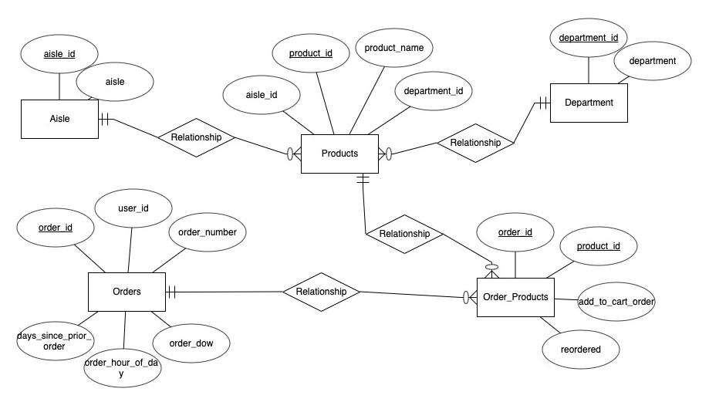
ER Diagram(Instacart)
Fig: 1.1: ER Diagram

Slide 5
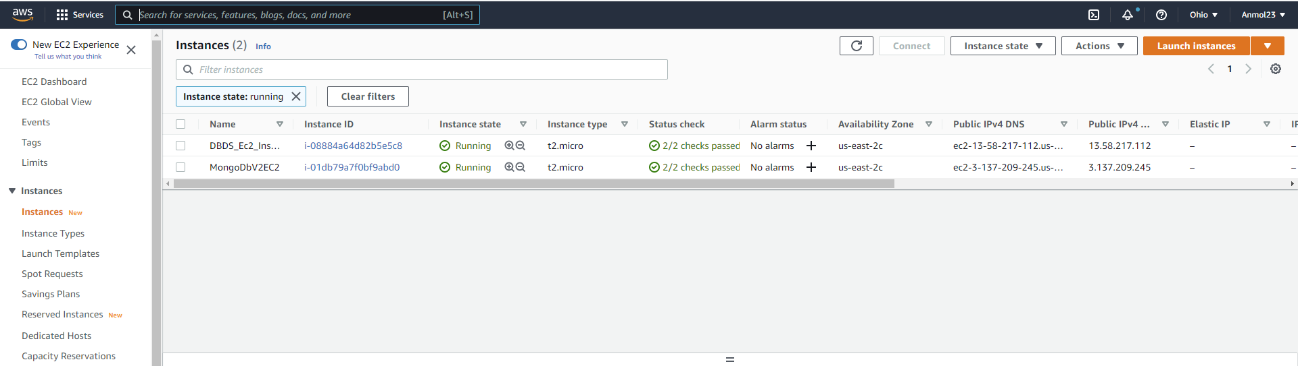
Ec2 Instances
Fig: 1.2: Live Instances

Slide 6
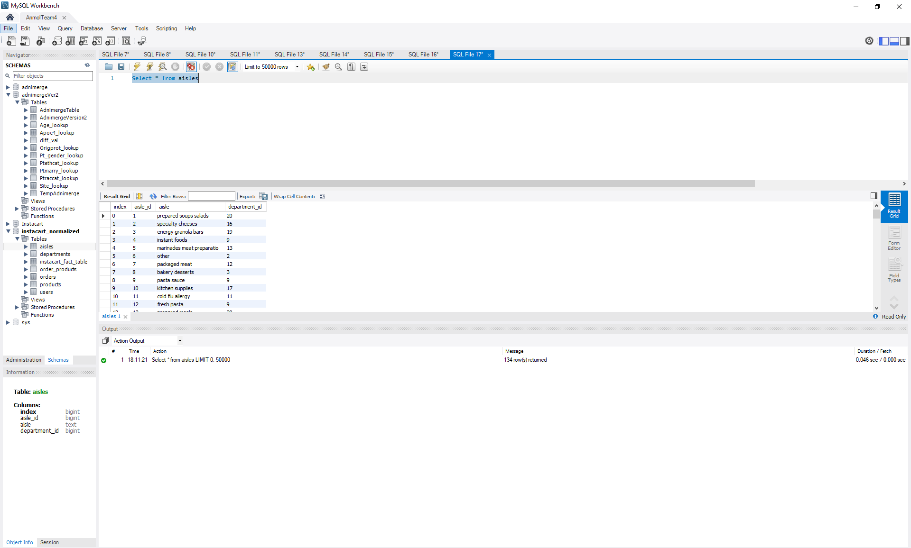
My Sql Workbench
Fig: 1.1: Live Instances
Fig: 1.3: Running Sql Work Bench

Slide 7
RDS INSTANCE
Fig: 1.4: Live Instances

Slide 8
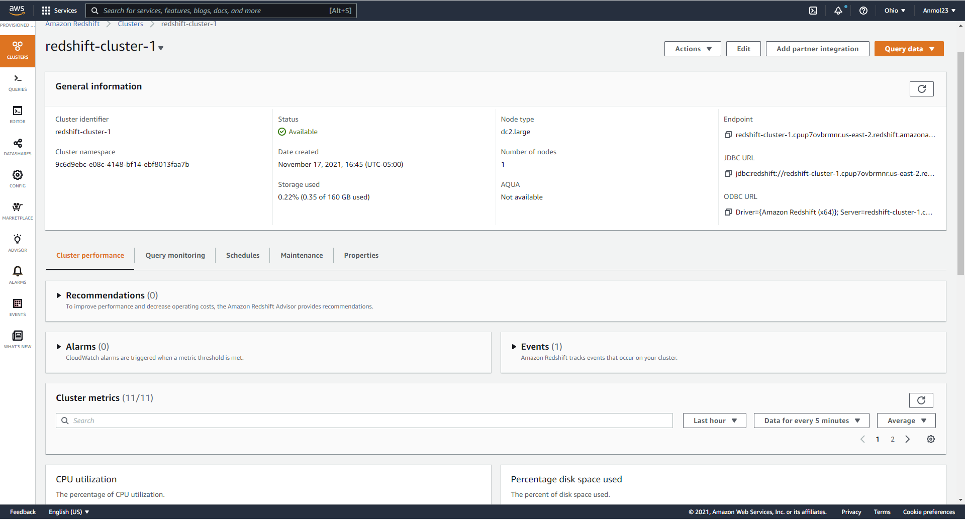
AMAZON REDSHIFT
Fig: 1.5: Redshift Instance

Slide 9
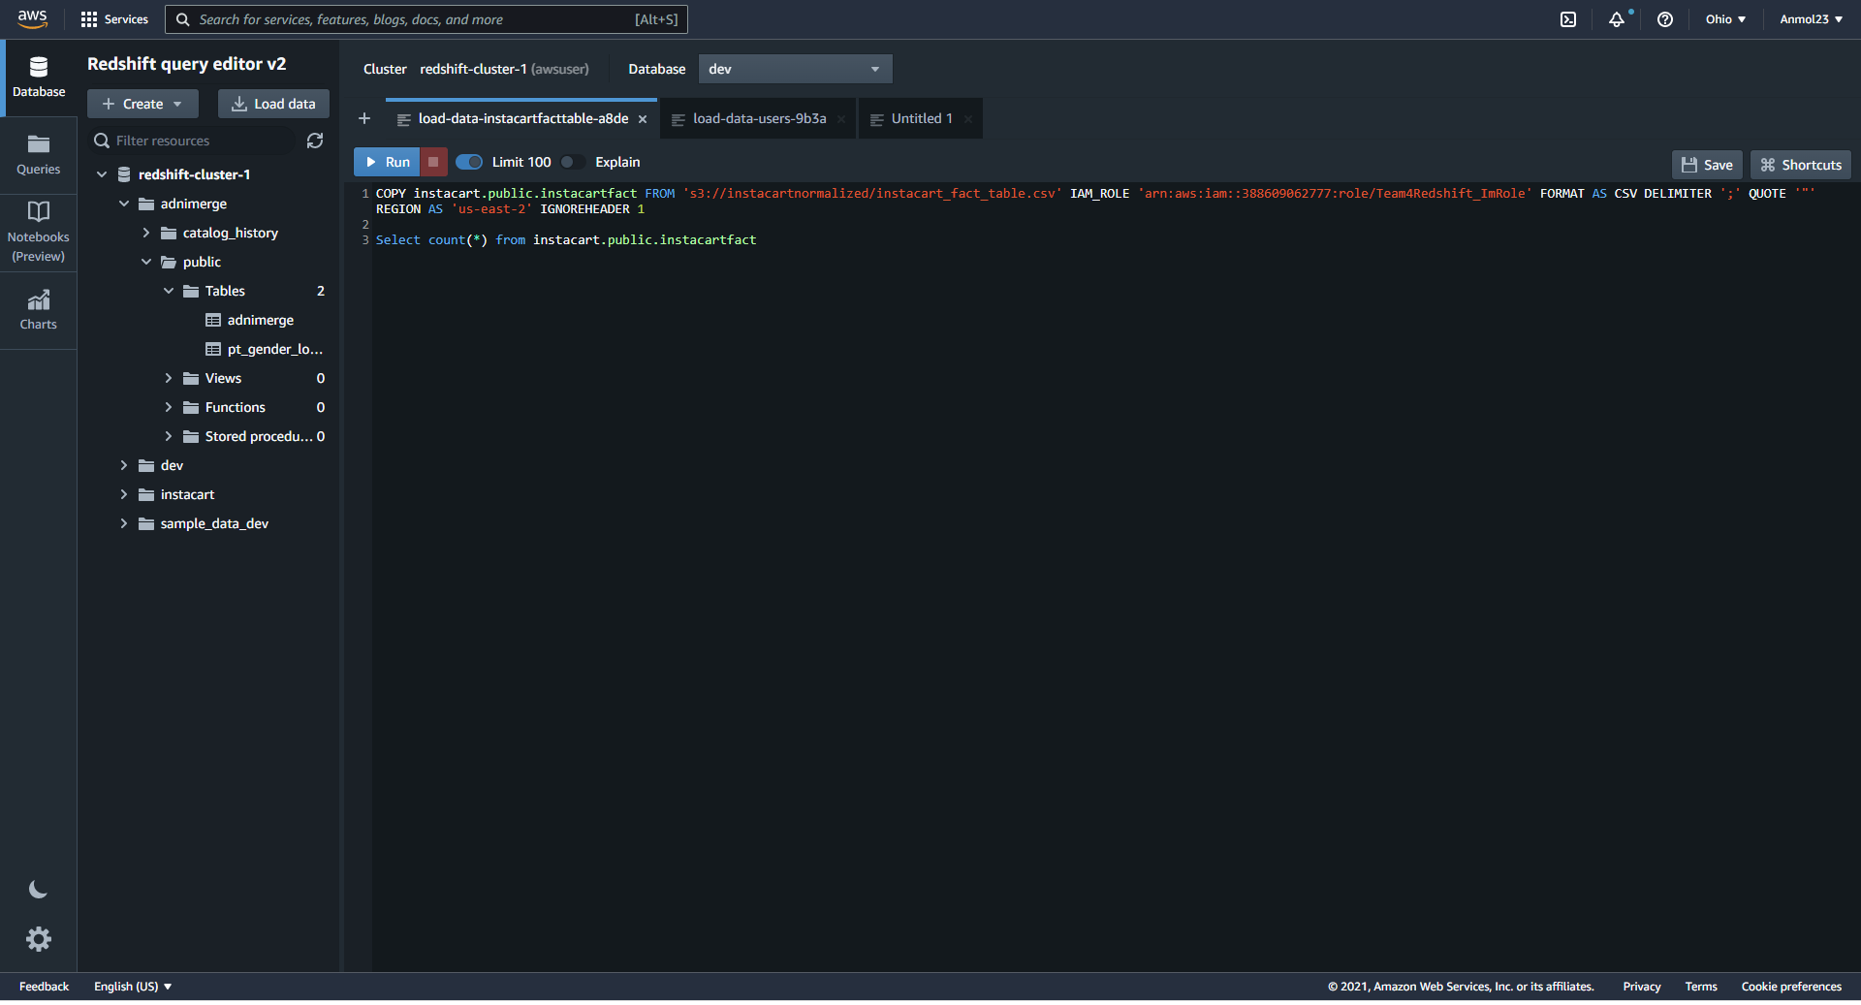
AMAZON REDSHIFT EDITOR
Fig: 1.6: Redshift Editor

Slide 10
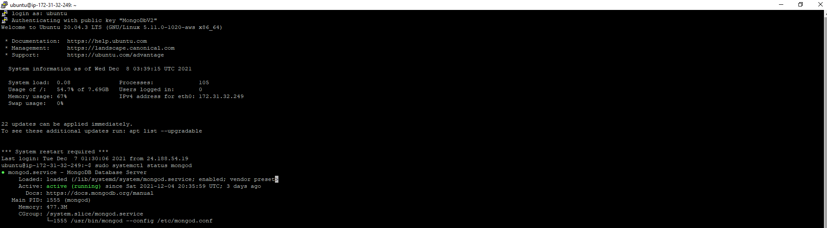
MONGO DB STATUS
Fig: 1.7: Mongo Status

Slide 11
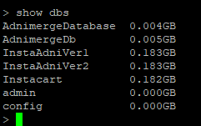
MONGO DATABASE
Fig: 1.8: Mongo Database

Slide 12
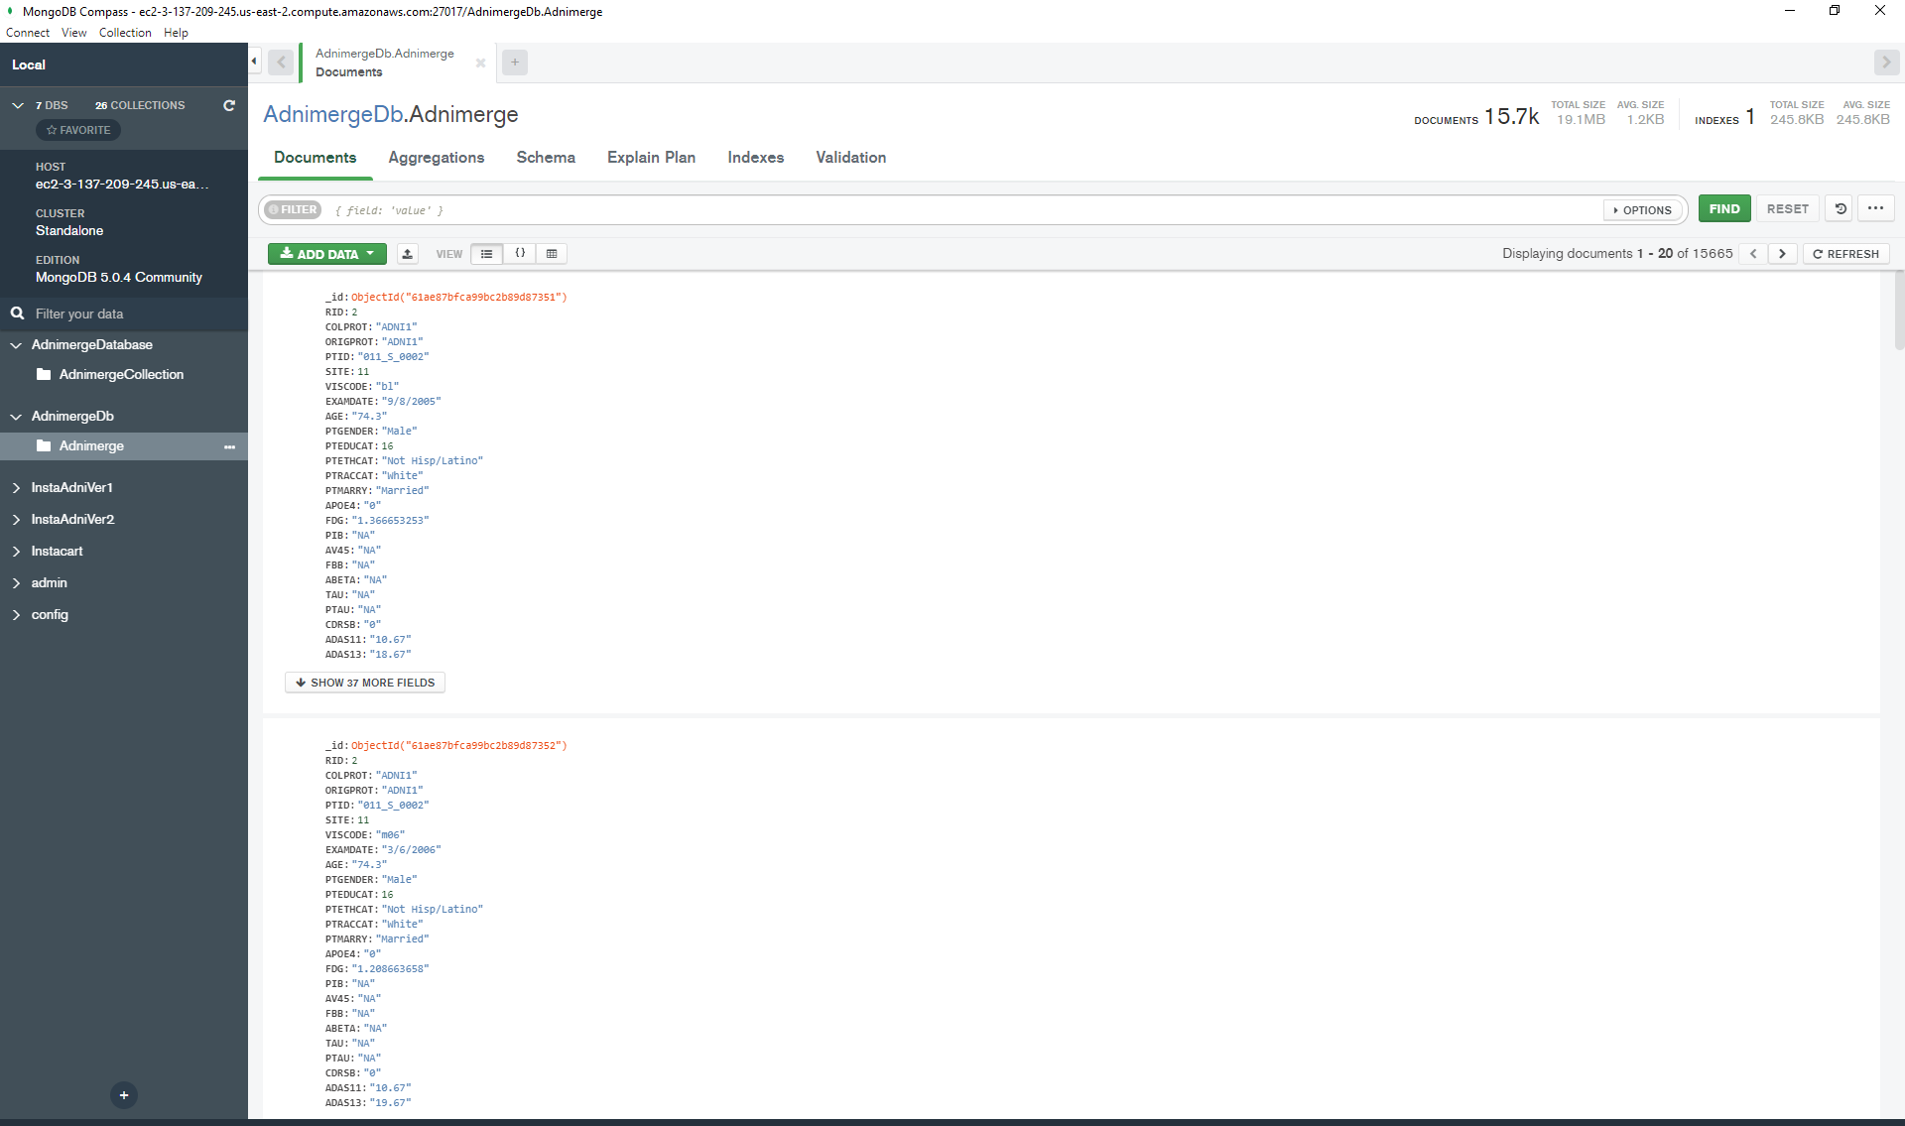
MONGO DATABASE
Fig: 1.9: Mongo Compass

Slide 13
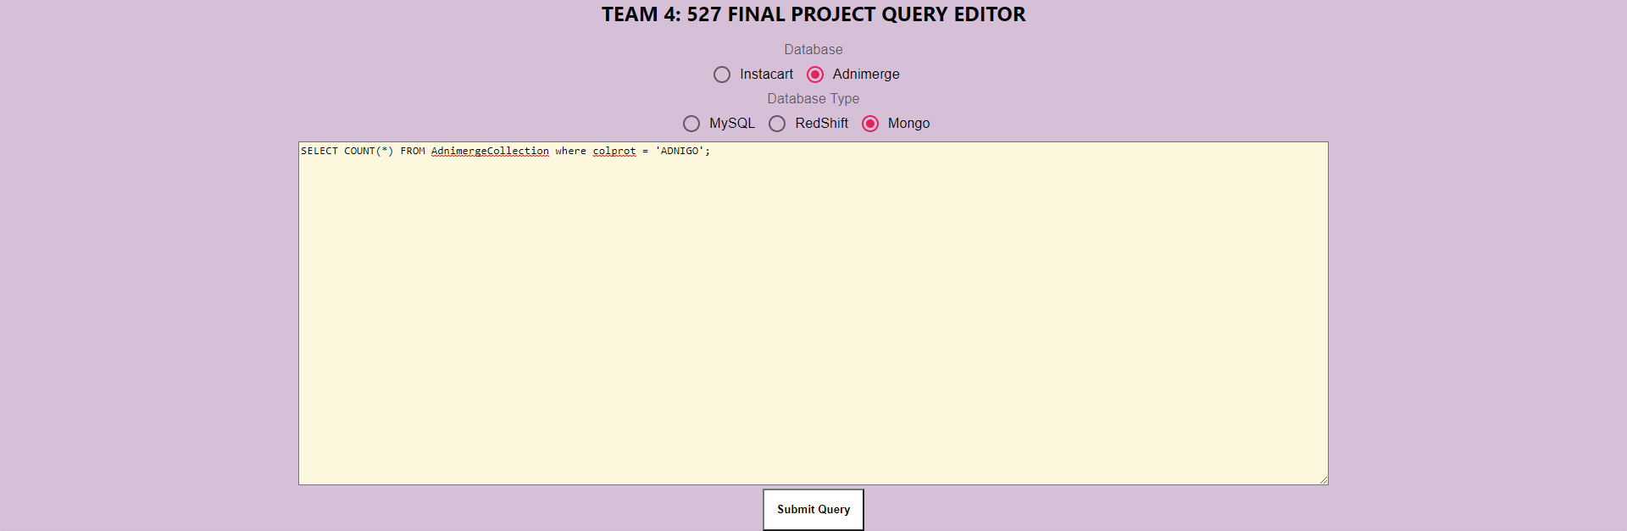
WEB APP
Fig: 1.10:Web App

Slide 14
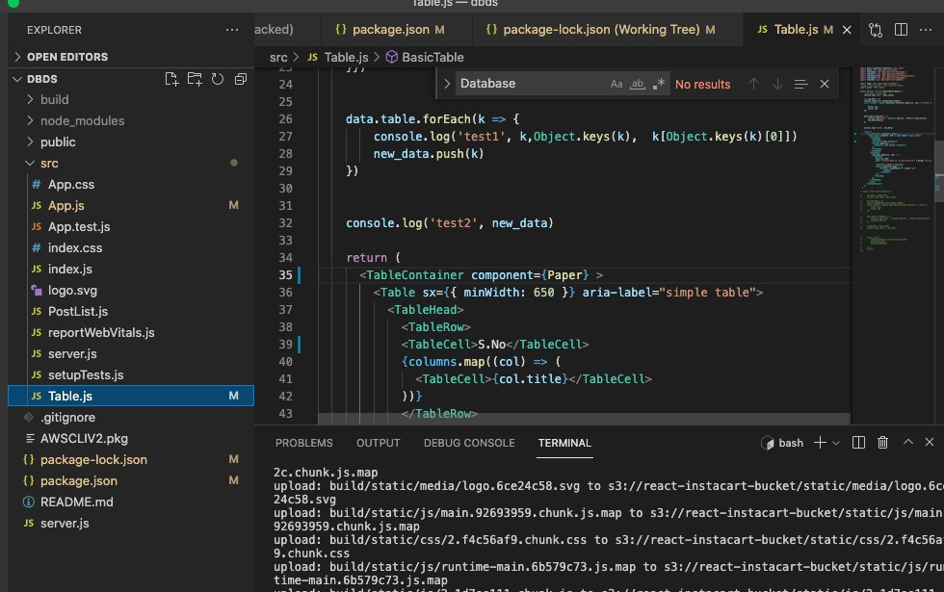
FRONT END
Fig: 1.11: Main App .js

Slide 15
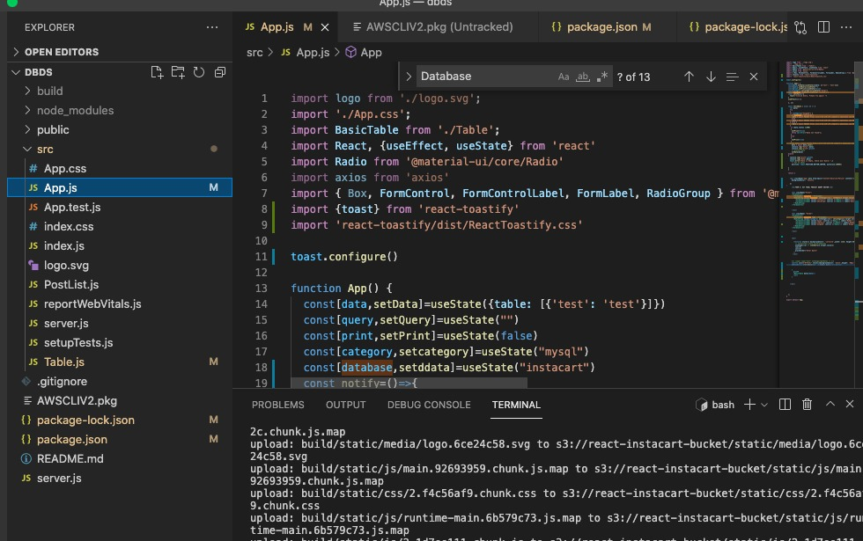
FRONT END
Fig: 1.12: Main Table

Slide 16
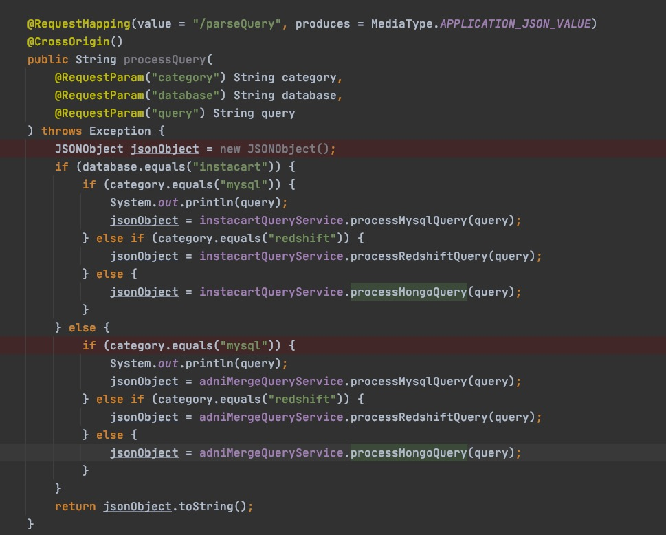
BACKEND
Fig: 1.14: Java code snippet

Slide 17
BACKEND II
Fig: 1.15: Code Snippet

Slide 18
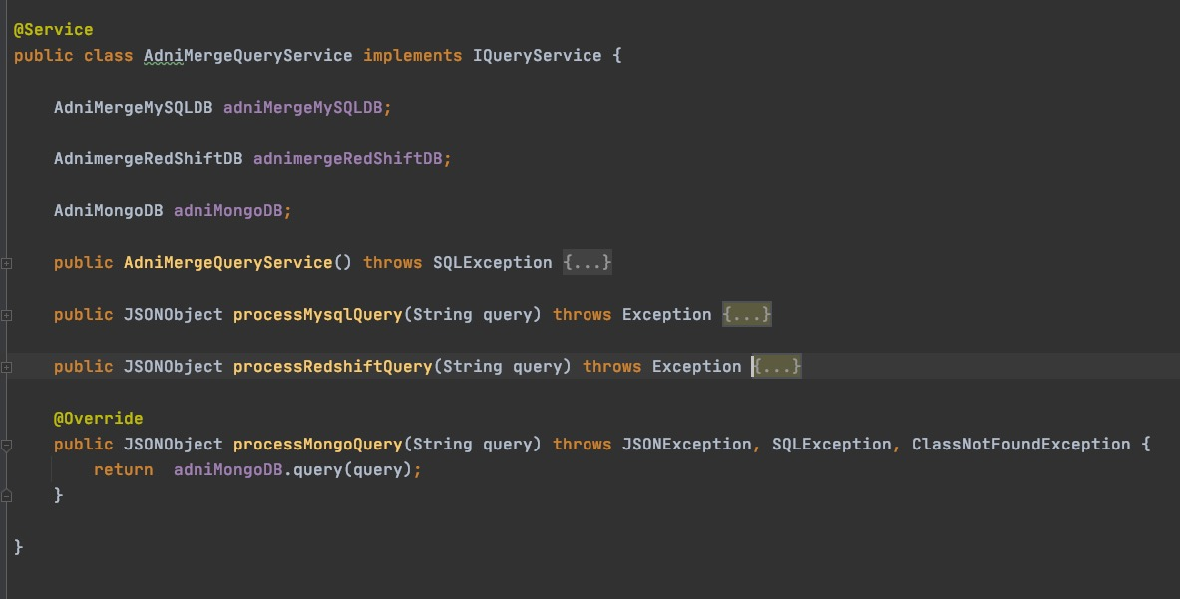
BACKEND III
Fig: 1.16: Code Snippet

Slide 19
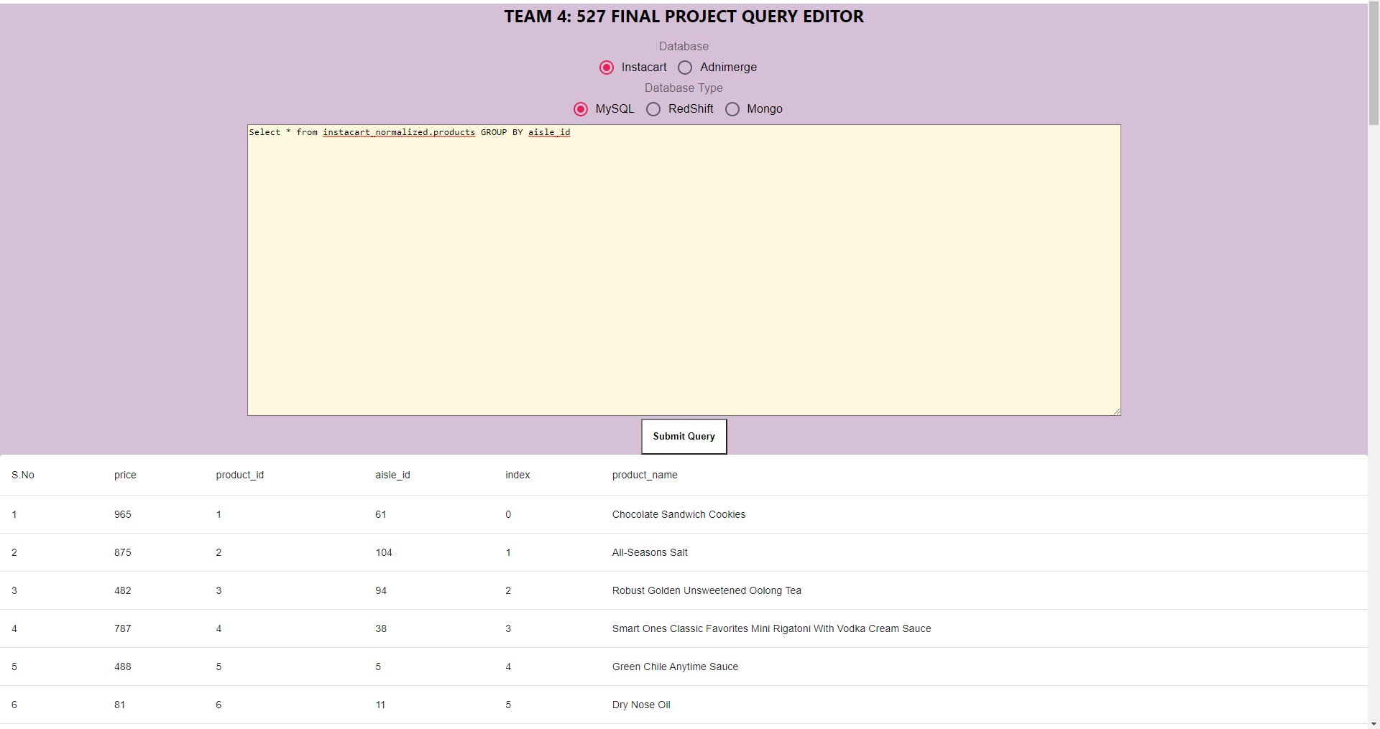
WEBAPP RESULT
Fig: 1.16: Code Snippet

Slide 20
THANK YOU

